Slide 1
GCP GenAI Leader Certification
Kick-Off
Presenter name
02.03.2025

Slide 2

Agenda
1
Why are we here today?
2
Mutual expectation
3
GCP GenAI Leader learning path
4
Learning schedule
5
Important links and contacts

Slide 3
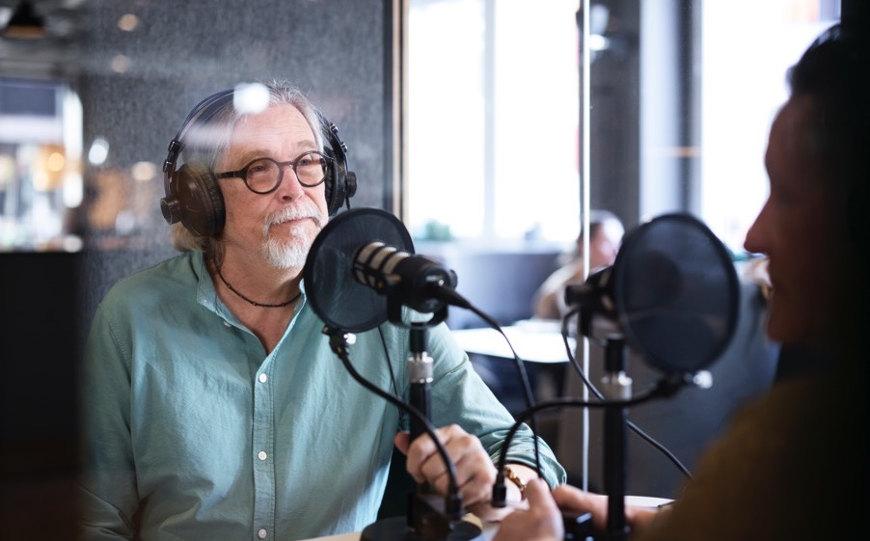
Why are we here today?
To talk about the newly launched GCP certification
GenAI Leader
Certification Details:
https://cloud.google.com/learn/certification/generative-ai-leader
Learning Path:
https://partner.cloudskillsboost.google/paths/1952

Slide 4

Mutual Expectations
Complete the learning path on time
Attend Exam Readiness Workshop
Book the exam as soon as you receive the voucher
Take up the exam as per schedule
Assistance and Guidance
No follow-up post 2 weeks
Rewards for each certification completed before 15th July

Slide 5
Day-Wise Learning Plan
Sr. No | Day | Course | Duration | Link
1 | Day-1 | Exam details | 30 mins | https://cloud.google.com/learn/certification/generative-ai-leader
2 | Day-1 | Gen AI: Beyond the Chatbot | 1 Hr, 30 mins | https://partner.cloudskillsboost.google/paths/1952/course_templates/1268
3 | Day-2 | Gen AI: Unlock Foundational Concepts | 1 Hr | https://partner.cloudskillsboost.google/paths/1952/course_templates/1265
4 | Day-2 | Gen AI: Navigate the Landscape | 1 Hr, 15 mins | https://partner.cloudskillsboost.google/paths/1952/course_templates/1261
5 | Day-3 | Gen AI Apps: Transform Your Work | 1 Hr, 45 mins | https://partner.cloudskillsboost.google/paths/1952/course_templates/1266
6 | Day-4 | Gen AI Agents: Transform Your Organization | 2 Hrs, 15 mins | https://partner.cloudskillsboost.google/paths/1952/course_templates/1267
7 | Day-4 | Exam Readiness Workshop | 1 Hr, 30 mins | Invite will be shared soon
8 | Day-5 | Exam Readiness Workshop | 1 Hr, 30 mins | Invite will be shared soon
9 | Day-5 to Day 14 | Exam (Preferably at exam center) | 1 Hr, 30 mins | https://cp.certmetrics.com/google/en/home/dashboard

Slide 6
Important Links and Contacts
Learning Path
https://partner.cloudskillsboost.google/paths/1952
Practice Questions
https://docs.google.com/forms/d/e/1FAIpQLScNn5oUIFeMQjtsHilQsJPxDsnP-0DbhDVsIXaBeCmPj-dgYw/viewform
Certmetric Account
https://cp.certmetrics.com/google/en/login
Exam booking
Contact for voucher
https://webassessor.com/googlecloud
LnTT Contact
cloud-partner-training@google.com
Contact only if you do not receive voucher 1 day after completing the course
Prachi.r.joshi
Poorva.kulkarni
Mandatory for booking exam. Login with Accenture email id

Slide 7
Happy Preparations & All the Best ..!!
Certifications aren't just papers;
they are passports to new opportunities.

